Slide 1
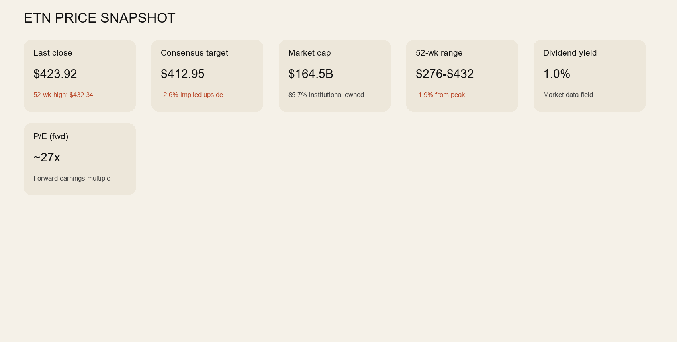
Eaton Corporation plc (ETN)
Visual investment deck | Generated from Veritas report assets
Current status: PULLBACK ONLY
Trend quality is strong, but price is pressing highs and current entry quality is poor. Wait for a disciplined pullback or a better-defined reset.
Current price $423.92 vs consensus target $412.95
Analyst rating: 1.7 - Buy

Slide 2
Executive Summary
What matters now
Close
$423.92
52-wk high $432.34
Consensus target
$412.95
28 analysts
Current stance
PULLBACK ONLY
Action status now
Business quality remains credible in Industrials / Specialty Industrial Machinery
Market cap $164.5B with 85.7% institutional ownership
Forward P/E ~27x and dividend yield 1.0%
Target upside currently -2.6%
20D / 50D / 200D: 389.3 / 375.6 / 361.2
Support / resistance: 343.5 / 424.5
Use the chart to decide timing, not the business story alone
Respect entry quality and opportunity cost

Slide 3
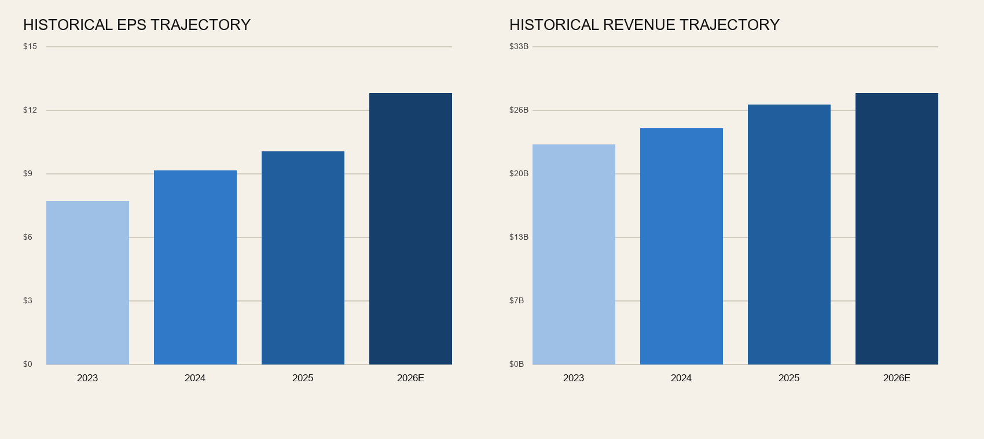
Historical Financial Trend
Ticker-level revenue and EPS history
Use this slide to check whether the business trend supports the story
A good trend does not eliminate timing risk, but it does separate quality from hype

Slide 4
Technical and Action Read
Why the current verdict is what it is
20D / 50D / 200D
389.3 / 375.6 / 361.2
Trend posture snapshot
Support / resistance
343.5 / 424.5
Recent range context
Action
PULLBACK ONLY
Veritas action state
Trend quality is strong, but price is pressing highs and current entry quality is poor. Wait for a disciplined pullback or a better-defined reset.
Ask whether the chart supports action now or only after a better setup forms
Keep the business case separate from the entry decision
Upgrade only after cleaner trend structure or better entry quality
Downgrade if the setup deteriorates further or valuation support weakens
Use the deployment sheet for final portfolio action

Slide 5
Decision Slide
Bottom line
Verdict
PULLBACK ONLY
Current action state
Target upside
-2.6%
Vs consensus target
Key level
343.5
Support to respect
ETN remains in active coverage
Trend quality is strong, but price is pressing highs and current entry quality is poor. Wait for a disciplined pullback or a better-defined reset.
Do not let a good story substitute for good timing
Use this deck as orientation, not as blind execution permission
Final deployment should still respect the written risk and trigger framework

